Slide 1
CSS-Bootstrap
Static Restaurant

Slide 2
Webpage's Component
index.html: main html file
style.css: css file
bootstrap

Slide 3
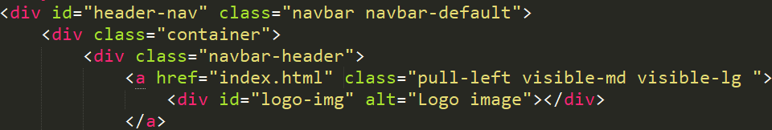
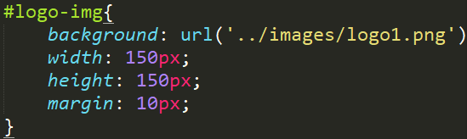
Header navigation bar(1)
Default navbar of bootstrap
container (wrapper)
Logo only visivle at md and lg browsers
Style.css:

Slide 4
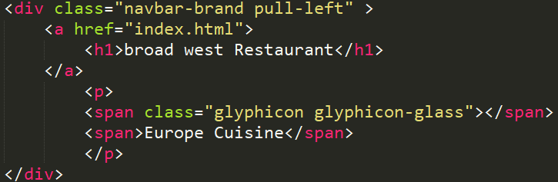

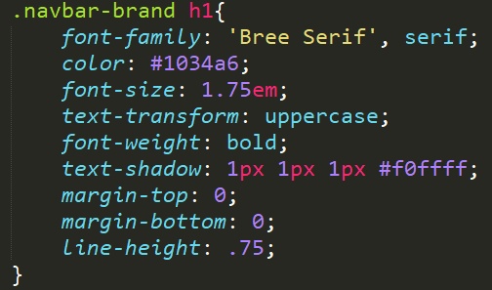
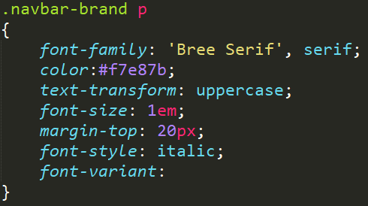
Header navigation bar(2)
The Glass Glyphicon
Float left
Remove <a>'s underline
<p>'s decorations
<h1>'s decorations

Slide 5
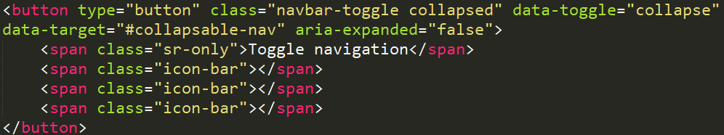
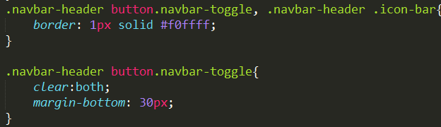
Header navigation bar(3)-Collapsable Menu
It's basically a button
Upon clicking, the button's properties will change...
...into the following properties

Slide 6
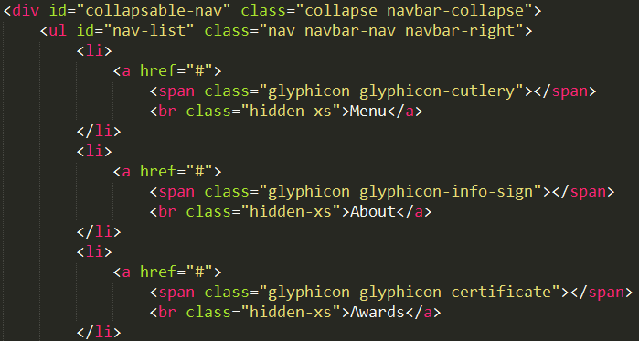
Header navigation bar(4)
Collapsable menu is an unordered list with special effects
Only shown when the browser's width reached extra small size

Slide 7
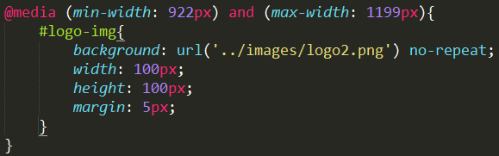
Header navigation bar(5)
When the browser's width shrinked to under 1199px but still over 922px, the logo will shrinks to a 100x100px one.

